Slide 1


Cloudy store

Slide 2
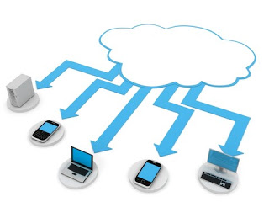
Presented By:
Abhishek Gupta
Adarsh Pandey
Anuj Arora
Aryan Varshney
Shivam Sharma
Yogesh Kumar
mentored by:
Ms. Kriti Bansal

Slide 3
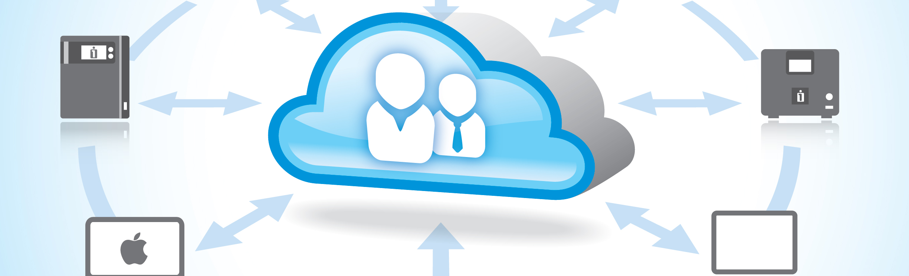
introduction
Cloud Storage is a model of computer data storage in which the data is stored over the cloud.
The physical storage spans over multiple servers (sometimes in multiple locations), and the physical storage environment is typically owned and managed by a hosting company. These cloud storage providers are responsible for keeping the data available and accessible, and keep the physical environment protected and running. People and organizations buy storage capacity from the providers to store user’s, organization’s or application’s data.

Slide 4

PROBLEM STATEMENT
Chance of Data Loss.
Offline Storage Mediums are Costly.
Carrying Of External Storage Devices.
Maintenance of Storage Device.

Slide 5
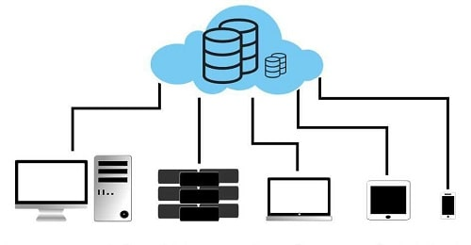
Objectives
To provide cloud-based data security.
To improve cloud-based file management.
To implement efficient file retrievals.
To make a cost effective storage system.

Slide 6
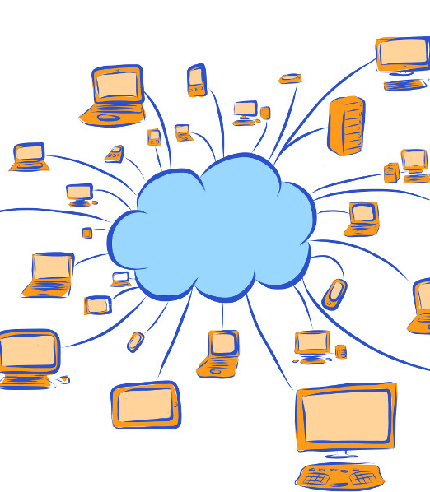
Modules
Admin - have access of all the data and user profiles.
User - have access to his/her profile and data only.

Slide 7

Purpose Of The Project
Save Expenditure.
Save Time.
Data Safety.
Ease in data sharing.

Slide 8
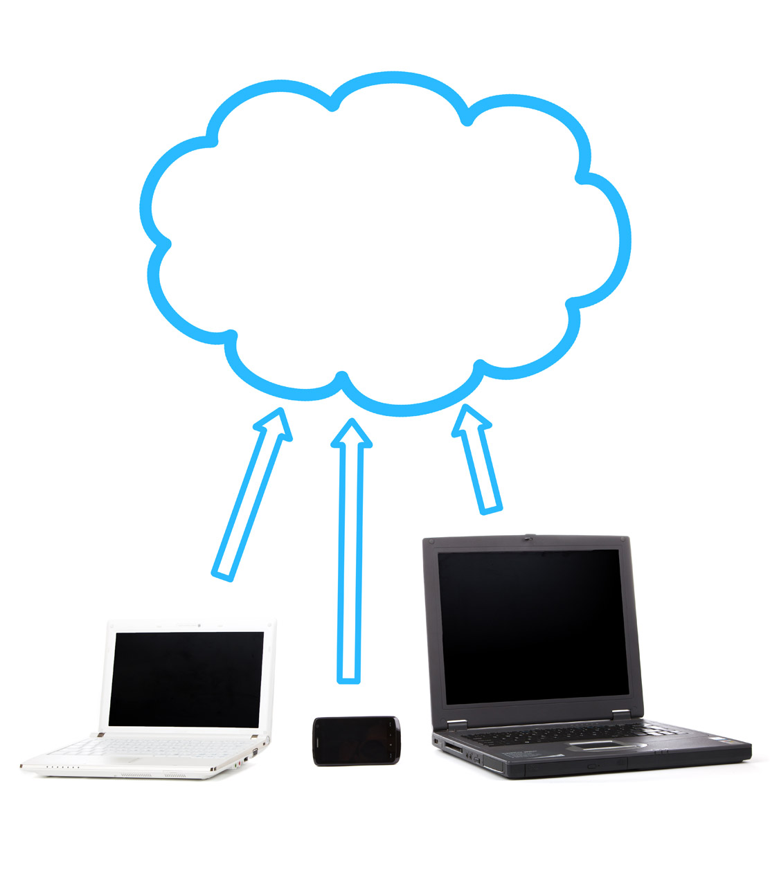
advantages
Data Security is Concerned.
Accessibility Over Any Place.
Immediate Access in Seconds of Time.
Data Recovery is much Easy.

Slide 9

Software Requirements
Operating System: Windows 7 & later. Application Server : XAMPP (Apache). Front-End: HTML5, CSS3. Back-End: JavaScript ,PHP. Database: Mysql CLOUD Database Connectivity : PhpMyAdmin.
Hardware Requirements
Processor: Intel Pentium IV, 2.4GHz
RAM: 512 MB
Hard Disk: 40 GB

Slide 10
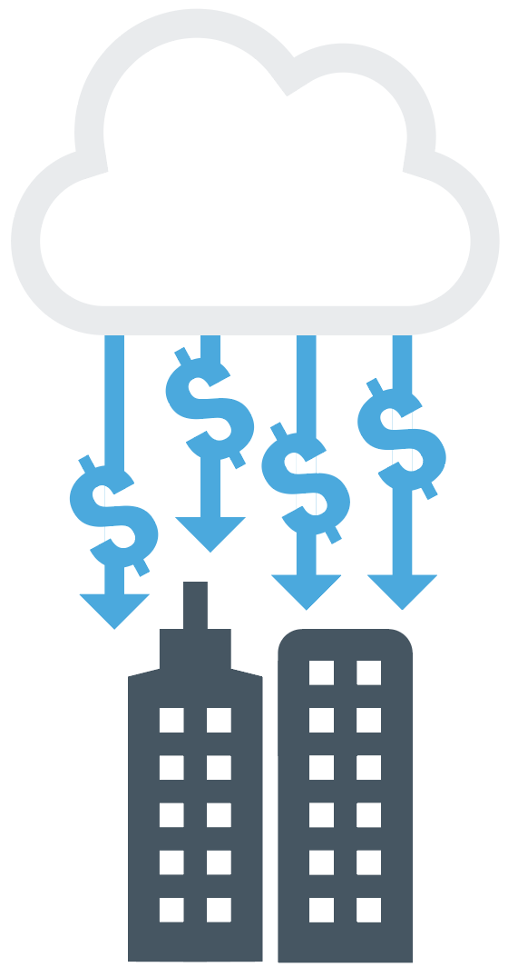
Thank You

